Slide 1

Decoding the DOC in the Age of Risk Containment
Part 1: Breaking Down the Jargon

Slide 2
A Simple Question:
“Client came back to jail for an 89-day furlough interrupt. When he was ready for release to CJC housing, he was re-case staffed and RSNed. Two months later, he was case staffed again and risk contained. I’m not sure if he filed a 74 or if he can do that now because his original interrupt was less than 90 days. Maybe he should just grieve and file a 75. It also might make sense talk to the Appellates about a PCR to see if he can somehow get resentenced to a split. He’s going to see the Board next month, but with a negative recommendation, high ORAS, and no release planning help from DOC, I don’t see him getting out, even if Dean is on the panel. He would also probably get stuck on Condition 16. Ideas?”

Slide 3
Interrupt/furlough interrupt
CJC
Case Staffing
RSN
Risk containment/Risk contained
74
75
PCR
Board
Negative recommendation
ORAS
Release planning
Dean
Condition 16

Slide 4
Minimum sentence tells you when you will first be eligible for release. (13 VSA § 7031)
It does NOT tell you when you will be released or what you have to do to be released.
Assigned caseworker
Case Planning
Case Staffing
What happens after sentencing or return to facility for violation of furlough or parole?
https://doc.vermont.gov/ > Policy Documents > Case Management Manual (371.02)
Notes:
Not going to talk about detainees – pretrial. So, 3 ways come into facility: new sentence after charge or VOP, furlough, parole. Briefly state difference between parole and furlough.

Slide 5
“Case Staffing”
A decision by DOC staff that determines
When an incarcerated individual is eligible for release
What that individual must do for release
Central/Local

Slide 6
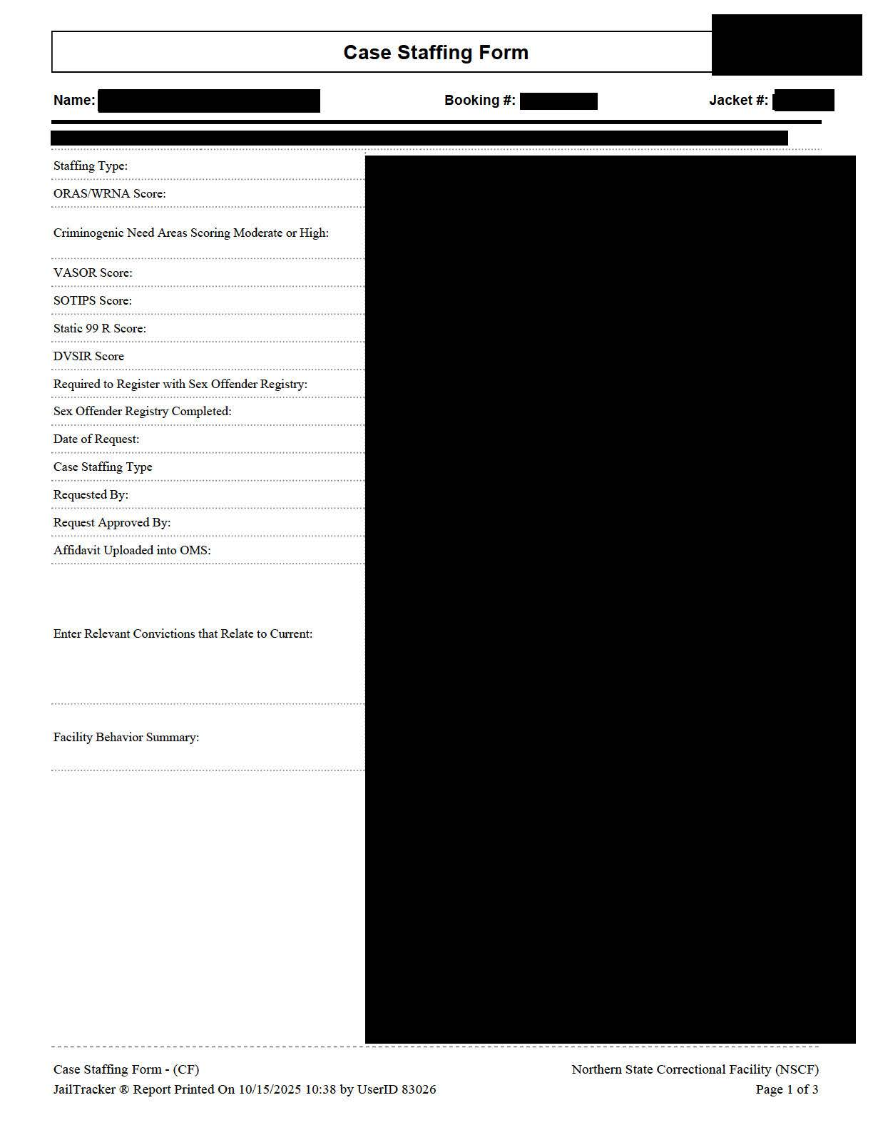

Slide 7
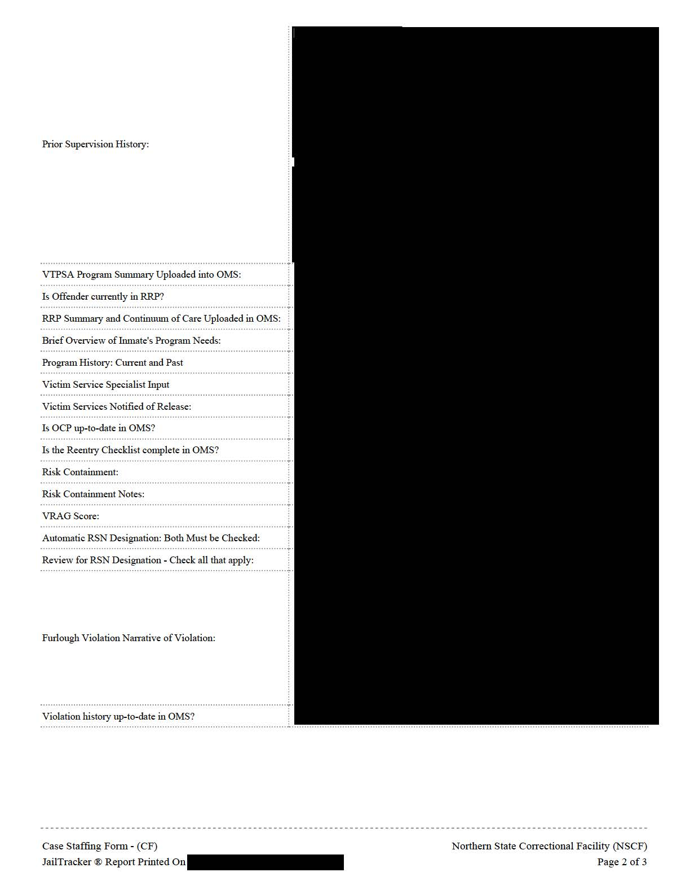

Slide 8
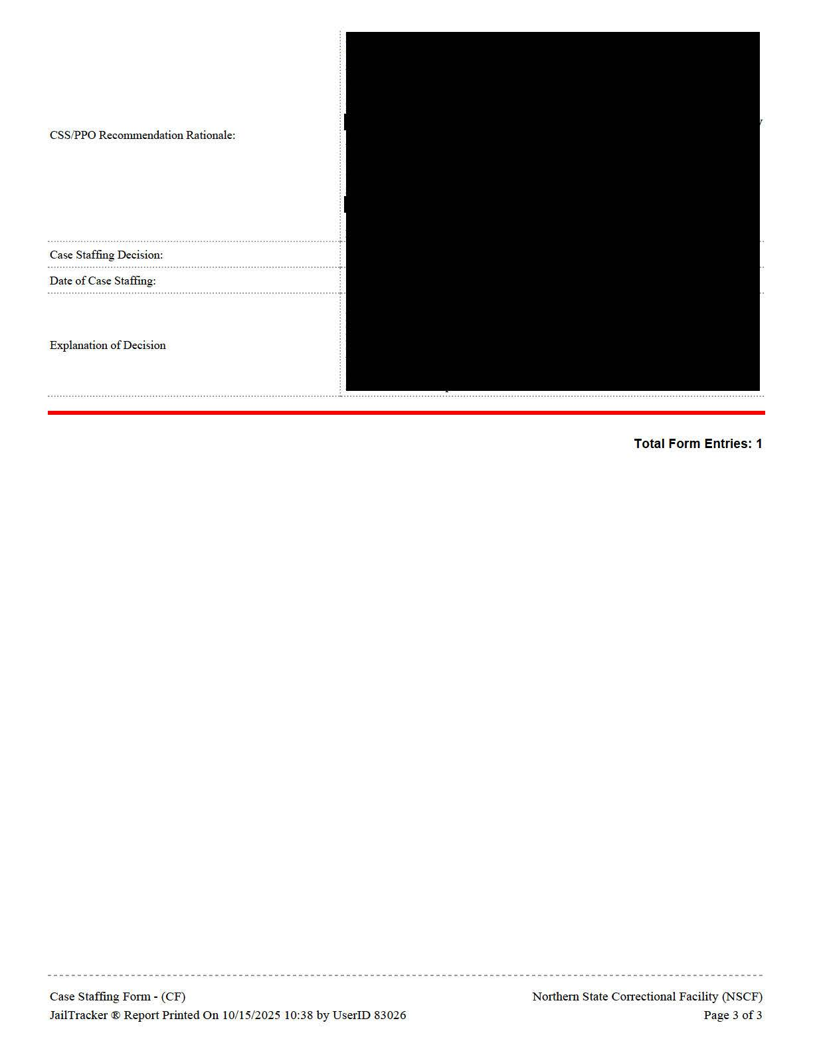

Slide 9
Highlights of case staffing
Risk assessments (ORAS, specialized)
Community release is/is not recommended and when (interrupt)
Recommending programming
Release sensitive notification (RSN)
Special release requirements (e.g., transitional housing)
Positive/negative parole recommendation
Risk containment

Slide 10

9 different screening tools
Assess the risks and needs of offenders at various points in the criminal justice system
Low/Medium/High Risk

Slide 11
Types of Information/
Categories:
Criminal History
Education, Employment, and Financial Situation
Substance Abuse and Mental Health
Criminal Attitudes and Behaviors
Family and Social Support

Slide 12
Clear
Less Clear
Unclear
Number of Prior Adult Felony Convictions
Employed at Time of Arrest
Ever Expelled from Suspended from School
Level of Satisfaction with Support from Family
Feels Lack of Control Over Events

Slide 13
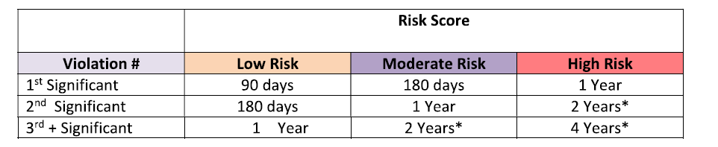
Implications of the ORAS
Becomes a label: “Mr. X is a high-risk offender”
Determines the interrupt if you return to custody from furlough or parole
https://doc.vermont.gov/ > Policy Documents > Response to Furlough Violations (430.11)

Slide 14
DOC Risk Containment Policy
Purpose
When the risk of harm posed by an incarcerated individual cannot be mitigated in the community, the DOC may refrain from releasing the individual, while under the DOC’s discretion, and use incarceration to contain the risk until it can be appropriately managed in the community.
Used to “identify individuals who pose a risk of dangerousness to the community if released.”
https://doc.vermont.gov/ > Policy Documents > Risk Containment Policy (371.10)

Slide 15
Identifying Individuals
Caseworker identifies
Living Unit Supervisor agrees
Case Staffing Central Committee reviews and formally designates

Slide 16
Who is eligible?
Prong 1: Type of Conviction
Conviction of Sex Offense (§ 5401(10)(A))
Sex Assault,
Agg Sex Assault
L & L
Sex Assault of Vulnerable Adult
Voyeurism (2nd)
Kidnapping w Intent to Commit Sexual Assault
Agg Sex Assault of Child
Human Trafficking
Related Fed. Convictions
Listed Offense (§ 5301(7))
Felony (§ 1)
(includes property crimes)

Slide 17
Prong 2: Behavioral
“Individual constitutes a threat to the life, safety, or physical or mental well being of others.”
Based on Evidence Establishing:
Pattern of Repetitive Behavior
Failure to restrain behavior and future likelihood death, injury or harm; or
Substantial degree of indifference
Any behavior of a brutal nature
Failure to control sexual or violent behavior
Continued violent behavior following interventions, sanctions, or programming

Slide 18
What DOC relies on
Number and nature of past offenses
Time span between offenses
Pattern of escalation of harm
Circumstances of offenses
DCF/ DAIL substantiations
Safety implications on victims

Slide 19
Decision & Notice
Must notify individual of the “specific reasons”:

Slide 20
Review of Risk Containment Classification
May petition for change in classification every 12 months
Must include substantive evidence of demonstrated change
In the meantime:
- No help with release planning (applications for transitional housing, ICOTS)
- Negative parole recommendation

Slide 21
Release Sensitive Notification (RSN)
If risk contained, automatically designated as RSN.
Can be designated RSN even without risk containment.
Governs release notifications to law enforcement, State’s attorney’s, Office Victim’s Services
“The DOC’s policy is to prepare and plan for the release and reintegration of individuals who are returning to the community following incarceration. This includes taking additional steps to notify and consult with all required parties and appropriate community members prior to the release of incarcerated individuals who are high profile or convicted of a serious crime.”
https://doc.vermont.gov/ > Policy Documents > Case Management Manual (371.28)

Slide 22
RSN Designation +
NO DOC Discretion for Release (Split or Max Out)
Law Enforcement Notification
Additional Notifications (e.g. victims)

Slide 23
RSN Designation +
DOC Discretion (Furlough/ Parole)
DOC Supports Release
DOC Does Not Support Release
Additional Notifications
Additional Release Plans
Timeframe for Next Review
Necessary Criteria to Gain DOC Support
DOC has 45 days to plan

Slide 24

There might be a trend scarier than risk containment.

Slide 25
2 Stories
Client A:
New sentence for misdemeanor negligent operation (serious injury). 60D-2 years.
At 60-day mark told he would be released tomorrow.
Has private residence (with partner of 15 years). Has work/owns business. Has treatment provider and relapse plan. Crime that brought him in occurred several years before sentencing.
Client B:
Furlough violation for losing housing – not significant, no new crimes charged. Underlying convictions are felonies.
Upon return, told will be released to approved housing.
Accepted to Community Justice Center Housing. Accepted responsibility and recognized risk behaviors. Set up treatment proiders (substance and mental health). Set up recovery coach. Has employment options and transportation.

Slide 26
1 Bad Case Staffing Outcome
Case staffed multiple times (worse each time)
“Resubmit in 1 year with revised release plan” and detail what he will do differently to mitigate risk.
Positive recommendation for parole denied
Release NOT supported
Designated RSN

Slide 27
Case Staffing Decisions
When eligible for community supervision
What programming or other planning needs to be done while incarcerated and upon release
RSN or Risk Containment
Any other possible means to thwart release
Minimum sentence tells you when you will first be eligible for release.
It does NOT tell you when you will be released or what you have to do to be released.

Slide 28

Decoding the DOC in the Age of Risk Containment
Part 2: Practice Strategies

Slide 29
What PRO can do:
Rule 74:
Appeals from decisions of agencies where statute provides for such appeal 28 V.S.A. § 724.
Furlough status for 90 days or longer for a technical violation
Rule 75:
Applies to challenges to government action (or inaction) where there is no specific statutory right to appeal.
Must exhaust the grievance process first.
Declaratory Judgment and Habeas Corpus

Slide 30
Question: What can trial attorneys do?
Answer:
Get a sentence with less DOC discretion.
Flat (or flatter) sentence.
Split sentence.
Sentences with safety valves?

Slide 31
Prepare for Parole/Furlough in Advance
Plan in advance: if front end of sentence is short, client should have a release plan before entering facility.
Make a clear record: Articulate parties’/court’s expectation of what a person has to do to be released. Might help get paroled over a negative recommendation.

Slide 32
Prepare the Warm Handoff
Email
If you have new offense and client already on supervision, email PRO in advance (Emily & David)
Advise
Know that parole/furlough revocation may be much worse than new sentence.
Reach out
If client calls panicking soon after sentencing, reach out to PRO (Emily & David)

Slide 33
What should none of us do?
Promise a client anything but their maximum.
Assume the DOC won’t change all of this tomorrow.

